Slide 1
BELT: A Pipeline for Stock Price Prediction Using News
Yingzhe Dong (Northeastern University, China)
Email: dongyingzhe99@sina.com
Da Yan (The University of Alabama at Birmingham)
Abdullateef Almudaifer (The University of Alabama at Birmingham)
Sibo Yan (Freddie Mac)
Zhe Jiang (The University of Alabama)
Yang Zhou (Auburn University)

Slide 2
Overview
Problem Motivations
Approach Overview
Data Collection and Preparation
Model for News Feature Extraction
Model for Temporal Prediction
Results and Conclusion

Slide 3
Overview
Problem Motivations
Approach Overview
Data Collection and Preparation
Model for News Feature Extraction
Model for Temporal Prediction
Results and Conclusion

Slide 4
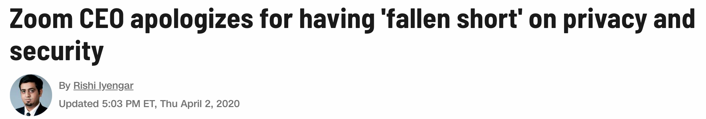
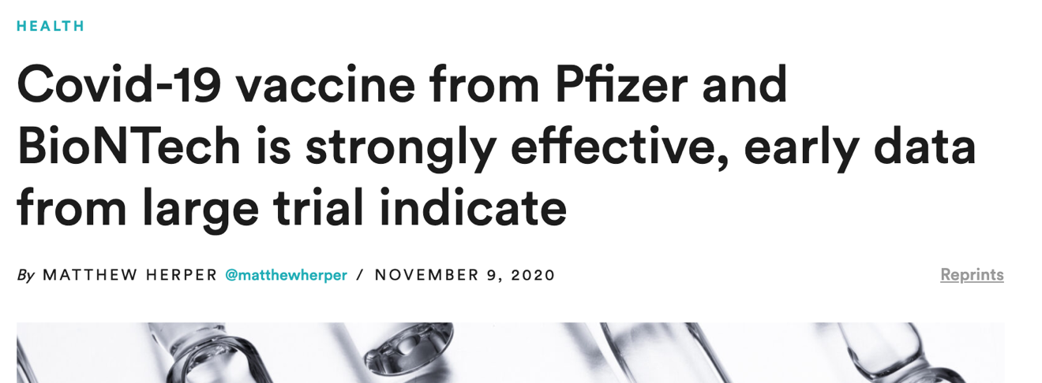
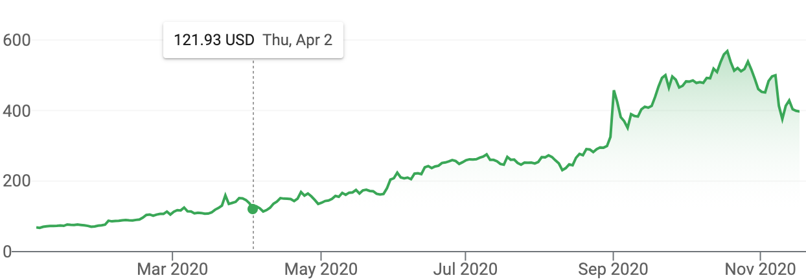
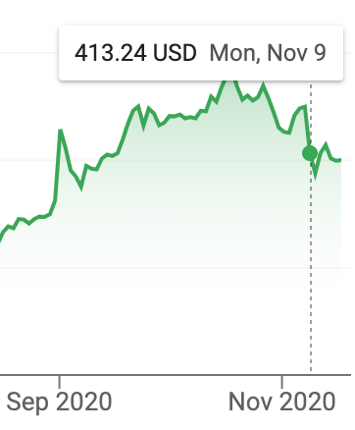
Problem Motivations
News can impact the stock price directions
Zoom

Slide 5
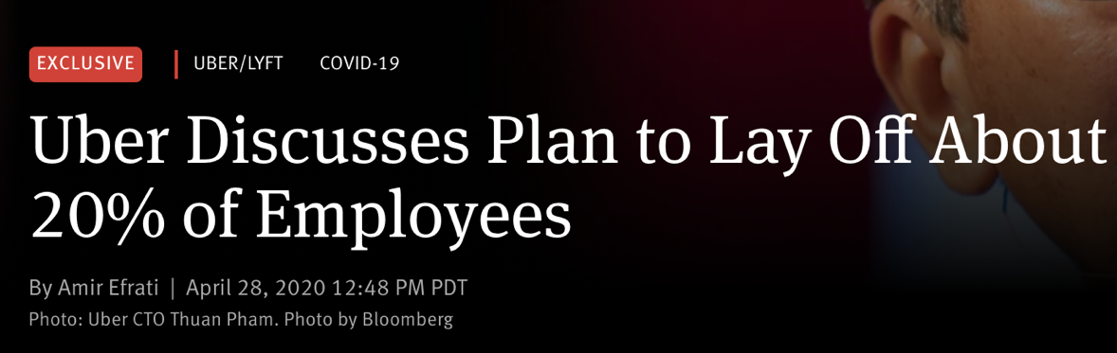
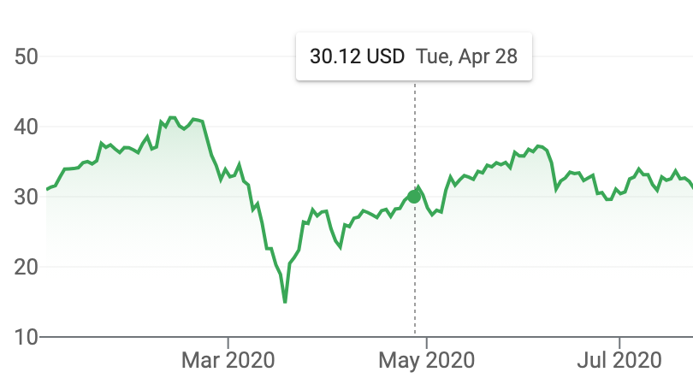
Problem Motivations
News can impact the stock price directions
Uber

Slide 6
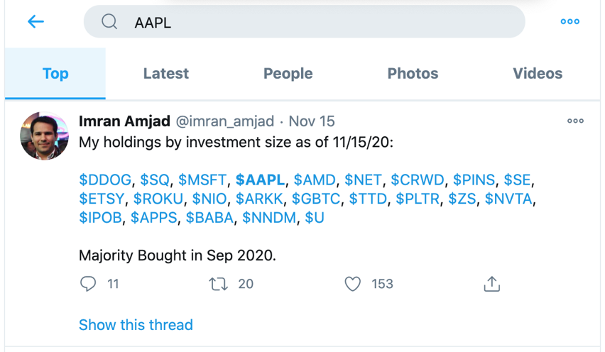
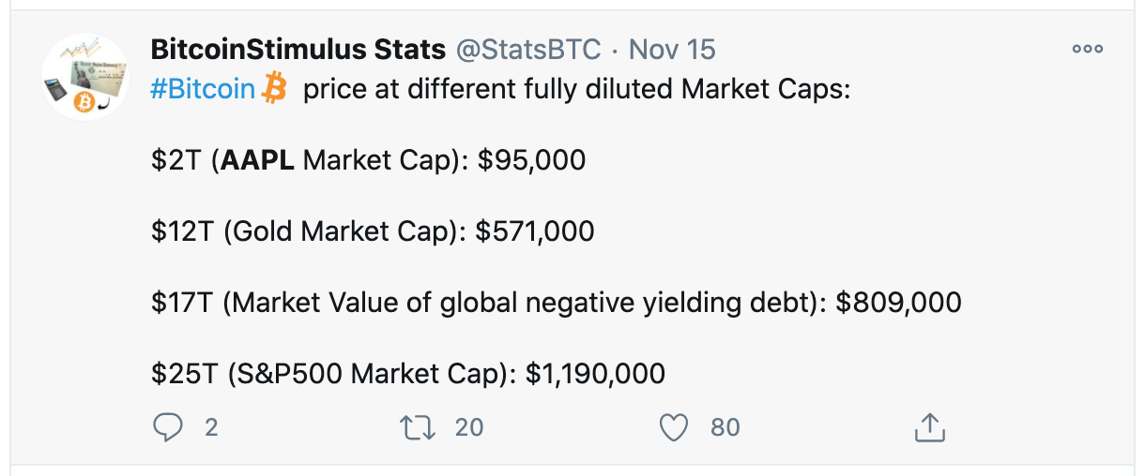
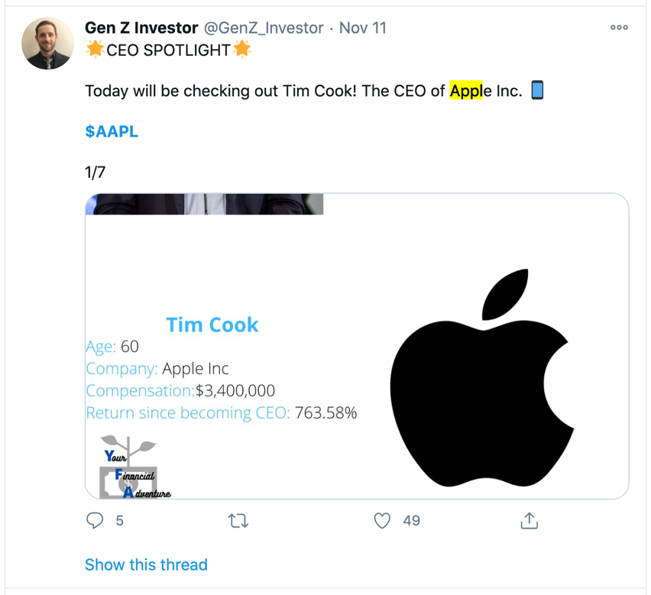
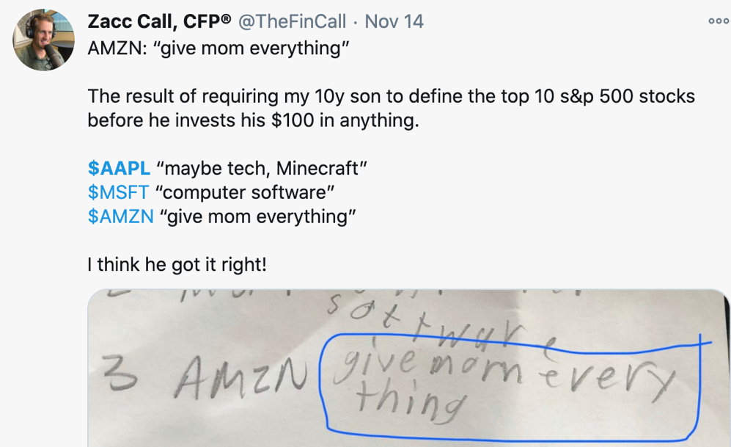
Problem Motivations
Search with stock symbol “APPL”
News Sources from Twitter
Quality?
Relevance?
Pretty Noisy!
Relevance?
Relevance?

Slide 7
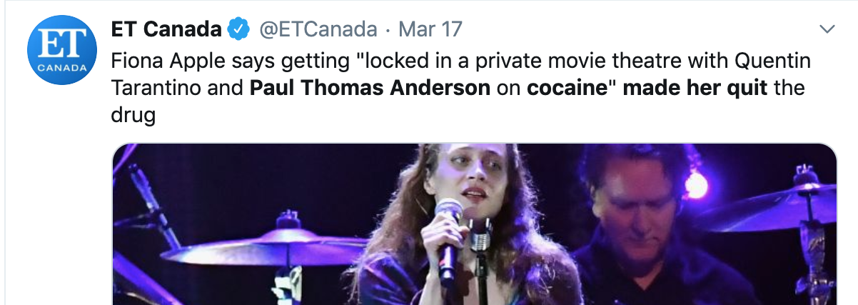
Problem Motivations
Search with “Apple”
Term Ambiguity
Regarding American singer-songwriter Fiona Apple

Slide 8


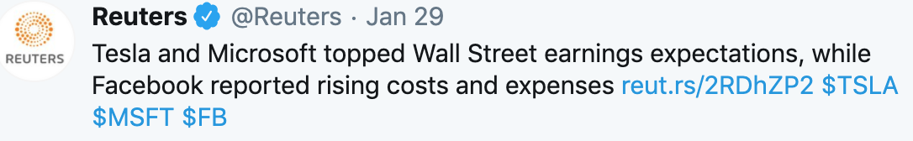

Problem Motivations
Attitudes in News
Context matters!

Slide 9
Problem Motivations
BELT = BERT + LSTM
Two breakthroughs in deep learning:
Sequence models (e.g., LSTM, GRU) for temporal predictions
Transformer models (e.g., BERT, GPT-3) for NLP
Feature extraction from historical data
Feature extraction from news

Slide 10
Overview
Problem Motivations
Approach Overview
Data Collection and Preparation
Model for News Feature Extraction
Model for Temporal Prediction
Results and Conclusion

Slide 11
Approach
Four Components
Twitter News Crawler
Relevance-Based Tweet Filter
Attitude-Based Tweet Feature Extractor
Feature integration by Autoregressive LSTM

Slide 12
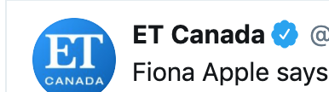
Relevance Filter
Crawler
Attitude Extractor

Slide 13

Relevance Filter
Crawler
Attitude Extractor

Slide 14
Relevance Filter
Crawler
Attitude Extractor

Slide 15
Temporal RNN Predictor
y
h₁
h₂
h₃
h₄
h₅
h₆
...
h_{T}
x₁
x₂
x₃
x₄
x₅
x₆
...
x_{T}

Slide 16
Overview
Problem Motivations
Approach Overview
Data Collection and Preparation
Model for News Feature Extraction
Model for Temporal Prediction
Results and Conclusion

Slide 17
Data Collection
We collect news from Twitter which is free
Other paid services can be used such as news from Factiva (https://professional.dowjones.com/factiva/)
now
1 week

Slide 18
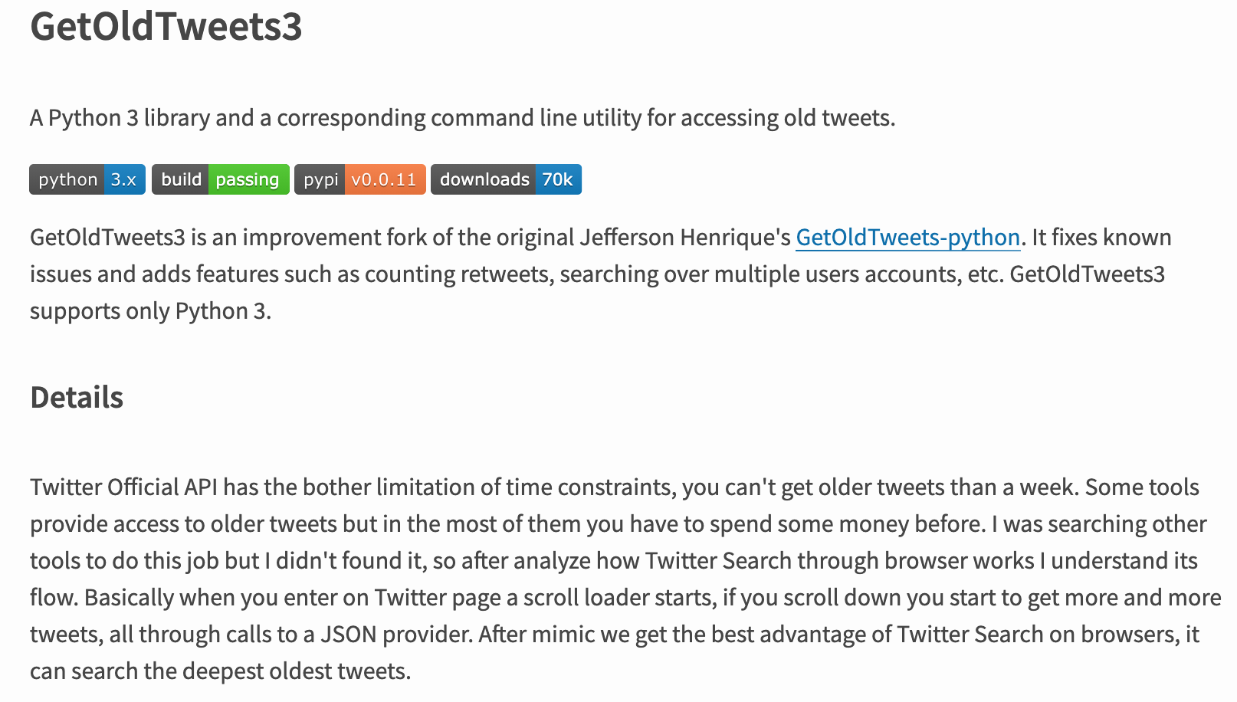
Data Collection
https://pypi.org/project/GetOldTweets3/

Slide 19
Data Collection
First Attempt: Crawling all tweets with the company name (e.g., Apple) and stock symbol (e.g., APPL)
Colloquial language and slangs
Everyone can comment, questionable credibility
Very Noisy!
Trained models are not good

Slide 20
Data Collection
Crawling only from official news accounts and credible investors
Examples
Top-10 News Accounts | Top-10 Investor Accounts
CNN Breaking News — @cnnbrk (55.4M followers) | Downtown Josh Brown@ReformedBroker
The New York Times — @nytimes (43.6M followers) | Joe Weisenthal@TheStalwart
CNN — @cnn (42.1M followers) | Vitalik Buterin@VitalikButerin
BBC Breaking News — @bbcbreaking (40M followers) | Charlie Lee@satoshilite
BBC World — @bbcworld (25.3M followers) | Barry Ritholtz@ritholtz
The Economist — @theeconomist (23.8M followers) | Wu-Tang Financial@Wu_Tang_Finance
Reuters Top News — @reuters (20.5M followers) | StockCats@StockCats
The Wall Street Journal — @wsj (16.7M followers) | Rudy Havenstein@RudyHavenstein
Time — @time (16.1M followers) | Liz Ann Sonders@LizAnnSonders
ABC News — @abc (14.4M followers) | Ivan the K@IvanTheK

Slide 21
Data Annotation
Tweets containing keywords like company names and their stock symbols
Time duration of crawling: Jan 1st to Apr 30th, 2020
Annotated by 5 PhD students
Statistics: 4,380 relevant tweets out of a total of 5,237 (due to quality control over news sources), among which only 2,830 have consistent attitude labels and are used for relevance training: 955 are positive, 982 are neutral, and 893 are negative

Slide 22
Overview
Problem Motivations
Approach Overview
Data Collection and Preparation
Model for News Feature Extraction
Model for Temporal Prediction
Results and Conclusion

Slide 23
Relevance Filter
Crawler
Attitude Extractor

Slide 24
Relevance Filter
No
Binary Classifier
YES
Attitude Extractor

Slide 25
3-Class Classifier
Attitude Extractor

Slide 26
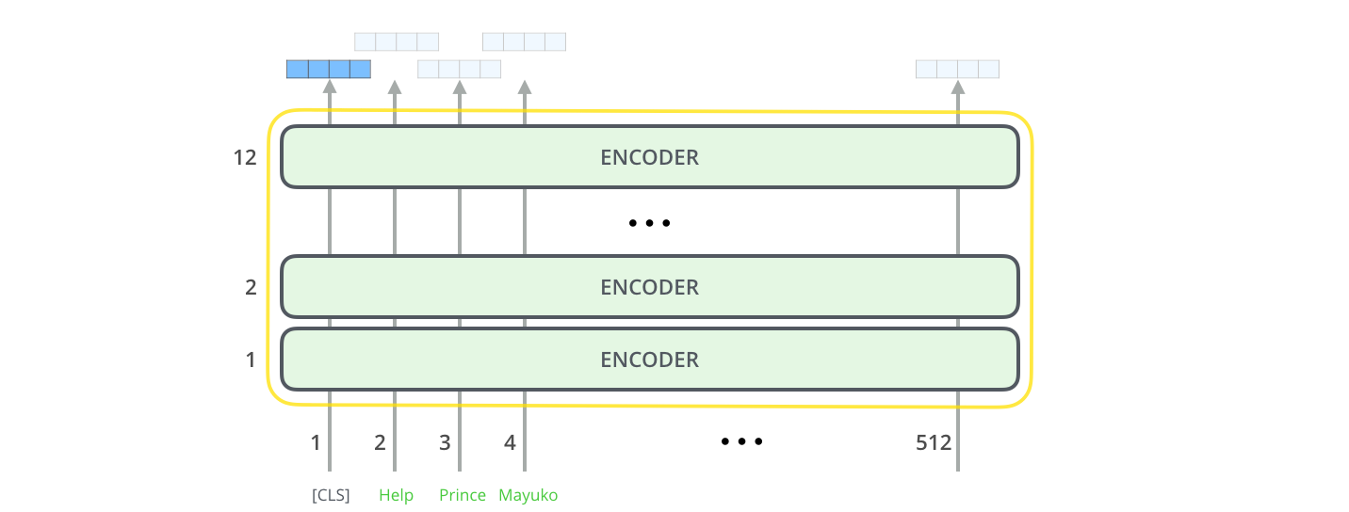
BERT Review
Pretraining with
Next Sentence Prediction (NSP)
Pooled Output
Sentence Features
Transformer Encoder
Input sentence

Slide 27
BERT Review
Masked Language Modeling (MLM)
Context-aware Word Features
Sequence Output

Slide 28
Our Model
Mask stock keywords (company names, symbols)
NLP data cleansing
[MASK]
Prediction for Facebook stock

Slide 29
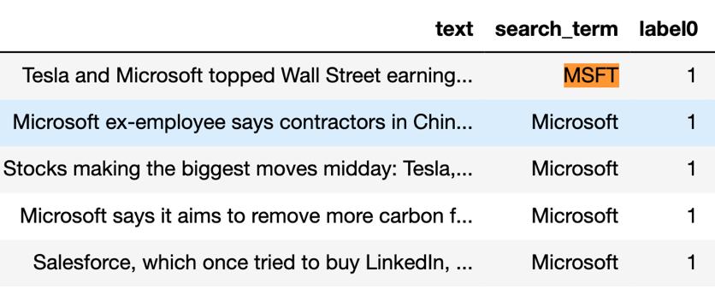
TSLA: Tesla, TSLA
MSFT: Microsoft, MSFT
… …
Text: Tesla and Microsoft topped Wall Street earning …
0
0
1
0
0
0
0 …
Bitmap: < >
Tesla and Microsoft …

Slide 30
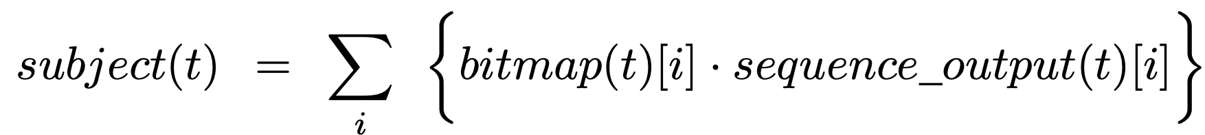
< p₋₁ , p₀ , p₁ >
< 1 , 0 , 0 >
softmax
cross-entropy loss
one-hot
< s₋₁ , s₀ , s₁ >
dense
Ground truth: rise, same, drop
tf.concat
dense
dense
0 0 1
0
0
1
0
0
0
0
0 …
Bitmap: < >
pooled
output
sequence output
Tesla and Microsoft …

Slide 31
Overview
Problem Motivations
Approach Overview
Data Collection and Preparation
Model for News Feature Extraction
Model for Temporal Prediction
Results and Conclusion

Slide 32
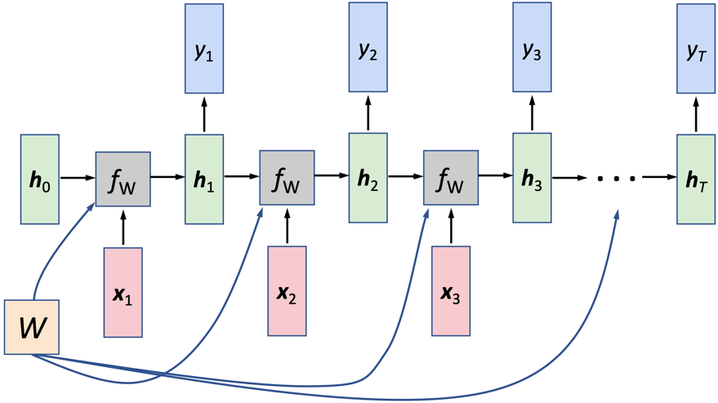
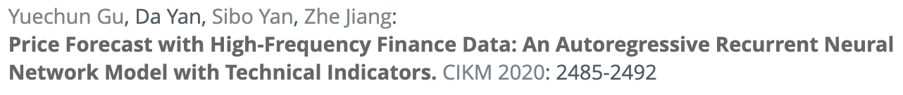
Our RNN Model
We use recurrent neural network (RNN) to capture the features of an entire temporal sequence
We adopt an autoregressive design, and use LSTM as the RNN unit to mitigate the vanishing gradient problem

Slide 33
Temporal RNN Predictor
y
^
p _{T +1}
h₁
h₂
h₃
h₄
h₅
h₆
...
h_{T}
x₁
x₂
x₃
x₄
x₅
x₆
...
x_{T}
p_{i}: median-share price for Day i

Slide 34
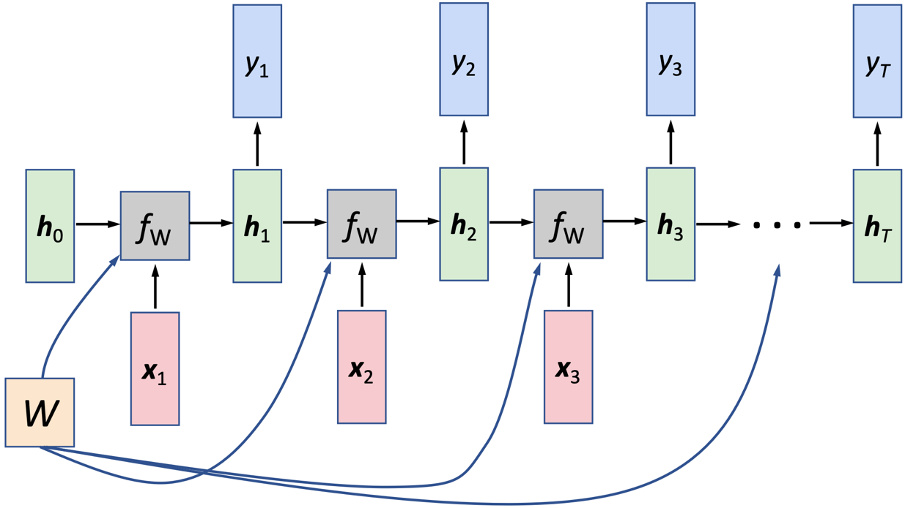
Temporal RNN Predictor
y_{T}
h₁
h₂
h₃
h₄
h₅
h₆
...
h_{T}
p₂
p₃
p₄
p₅
p₆
p₇
...
p_{T + 1}
MSE
...
L
L
L
L
L
L
L
x₁
x₂
x₃
x₄
x₅
x₆
...
x_{T}
y₁
y₂
y₃
y₄
y₅
y₆
p₁
p₂
p₃
p₄
p₅
p₆
p_{T}

Slide 35
Overview
Problem Motivations
Approach Overview
Data Collection and Preparation
Model for News Feature Extraction
Model for Temporal Prediction
Results and Conclusion

Slide 36
Results
Price Direction Classification
Directly derive from price regression
Treat as a classification problem

Slide 37
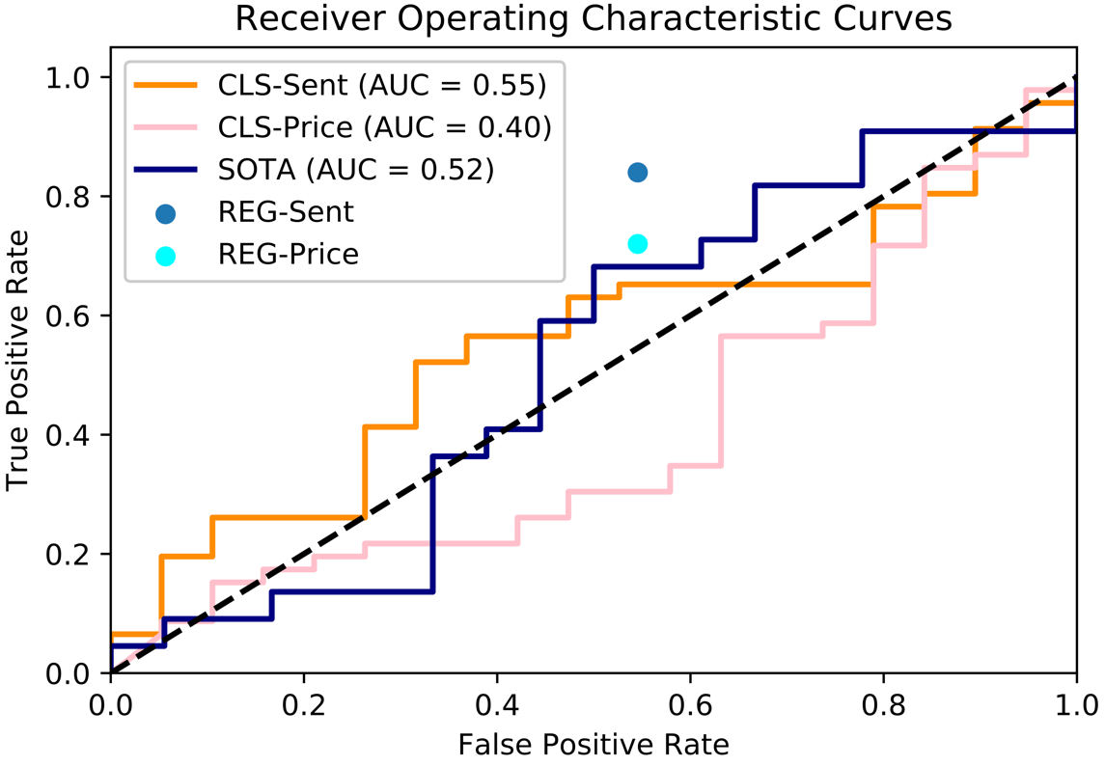
Results
Price Direction Prediction
SOTA is StockNet

Slide 38
Results
Price Regression
Stocks | REG-Price | REG-Sent
BA | 0.051 | 0.041
GM | 0.054 | 0.026
GE | 0.133 | 0.021
AAPL | 0.110 | 0.027
XOM | 0.085 | 0.021
MCD | 0.066 | 0.028
DOW | 0.049 | 0.037

Slide 39
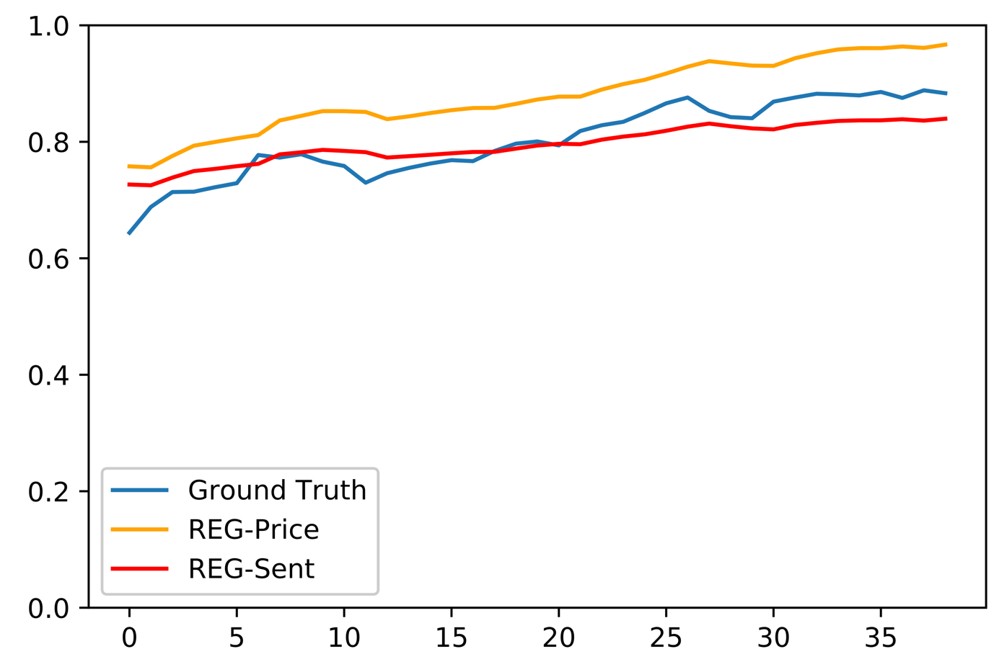
Results
Price Regression

Slide 40
If you have any questions, please email Yingzhe Dong at dongyingzhe99@sina.com
Thanks !
YAN, Da
Contact Info:
Email: yanda@uab.edu
Webpage: https://yanlab19870714.github.io/yanda

